Slide 1
INTRODUCTION TO PYTHON
By mastering these Python fundamentals, you will be well-prepared to dive into machine learning with a strong programming foundation. Here’s a quick checklist to ensure you’re ready to start:
Basic Syntax and Data Types
Control Flow (Conditionals and Loops)
Functions
Data Structures (Lists, Dictionaries, Tuples, Sets)
File Handling
Error Handling
Modules and Packages
Basic Object-Oriented Programming
Basic Input/Output

Slide 2

1. Basic Syntax
Understanding Python Syntax
Python syntax is designed to be readable and straightforward. Here are the key elements:
Indentation: Python uses indentation to define blocks of code. Proper indentation is crucial as it defines the structure and flow of your program.

Slide 3


Print Statement: Use the print() function to output text to the console.
Comments: Use the # symbol for single-line comments.

Slide 4

2. Variables and Data Types
Variables
Variables are used to store data. In Python, you don't need to declare the type of a variable; you just assign a value to it.

Slide 5


Data Types
Strings: Text enclosed in quotes (single or double).
Integers: Whole numbers.

Slide 6


Floats: Decimal numbers.
Booleans: True or False values.

Slide 7
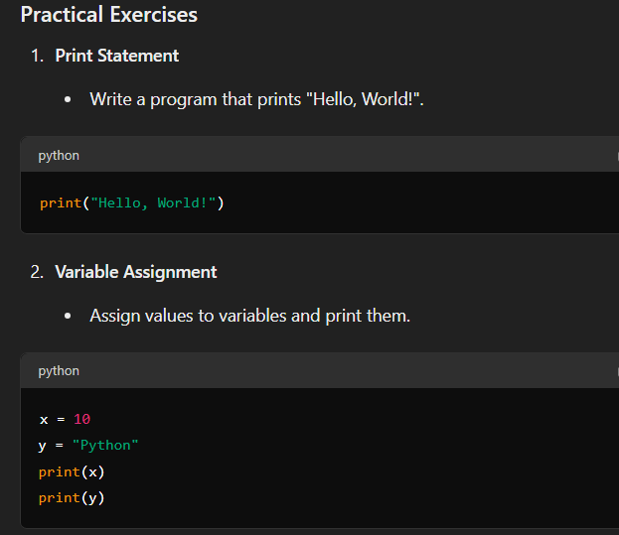

Slide 8
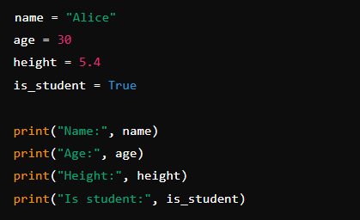
Data Types
Create variables of different data types and print their values.

Slide 9
2. Control Flow (Conditionals and Loops)
Control flow allows you to control the order in which statements are executed. This includes making decisions with conditionals and repeating actions with loops.
Conditionals
If, Elif, Else
If statement: Runs a block of code if a condition is true.
Elif statement: Stands for "else if" and allows you to check multiple conditions.
Else statement: Runs a block of code if all the preceding conditions are false.

Slide 10
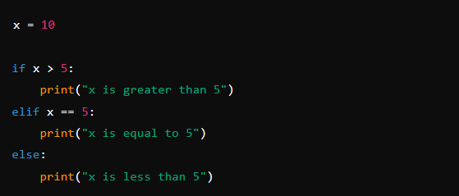

Slide 11
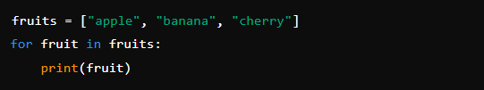
Loops
For Loops
For loop: Iterates over a sequence (like a list, tuple, dictionary, set, or string).

Slide 12
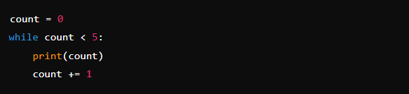
While Loops
While loop: Repeats a block of code as long as a condition is true.

Slide 13
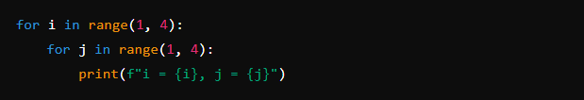
Nested Loops
Nested Loops: A loop inside another loop.

Slide 14
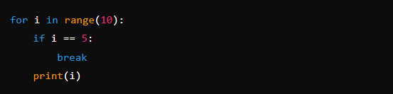
Break and Continue
Break: Exits the loop when a condition is met.

Slide 15
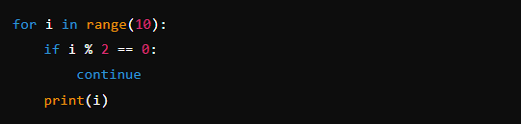
Continue
Skips the current iteration and continues with the next iteration.

Slide 16

3. Functions
Functions are a way to group reusable code into a single block that can be executed whenever it's called. They help in making the code modular, easier to understand, and reusable.
Defining and Calling Functions
Defining a Function: Use the def keyword, followed by the function name and parentheses ()
Calling a Function: Use the function name followed by parentheses.
greet()

Slide 17
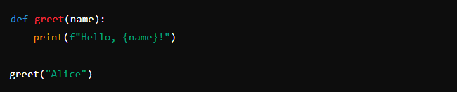
Parameters and Arguments
Parameters: Variables that are defined in the function definition.
Arguments: Values that are passed to the function when it is called.

Slide 18
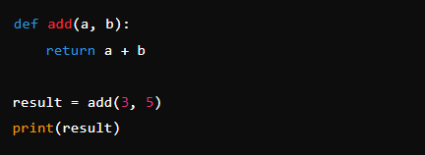
Return Statement
The return statement is used to send a result back to the caller.

Slide 19
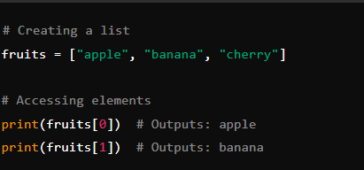
4. Data Structures
Understanding and effectively using data structures is crucial for writing efficient and readable code. Here are the key data structures in Python: Lists, Dictionaries, Tuples, and Sets.
Lists
Ordered, mutable collections of items. You can store different data types in a list.

Slide 20
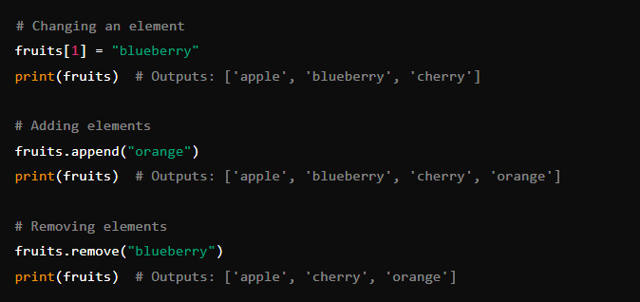
Modifying Lists

Slide 21
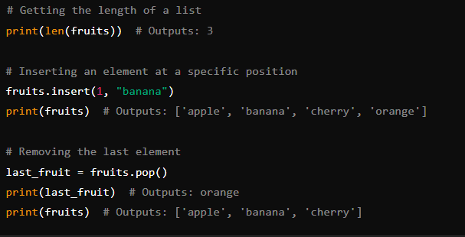
List Methods

Slide 22
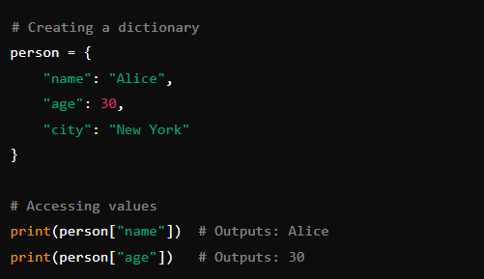
Dictionaries
Dictionaries: Collections of key-value pairs. Keys must be unique and immutable.
Creating and Accessing Dictionaries

Slide 23
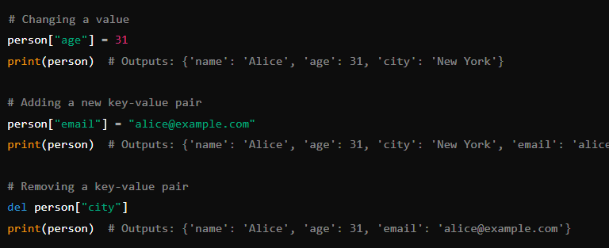
Modifying Dictionaries

Slide 24
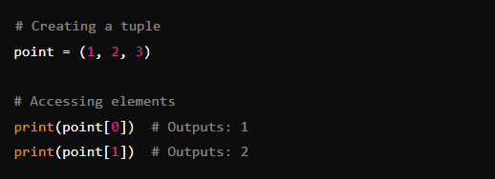
Tuples
Tuples: Ordered, immutable collections of items. They are similar to lists but cannot be changed after creation.

Slide 25
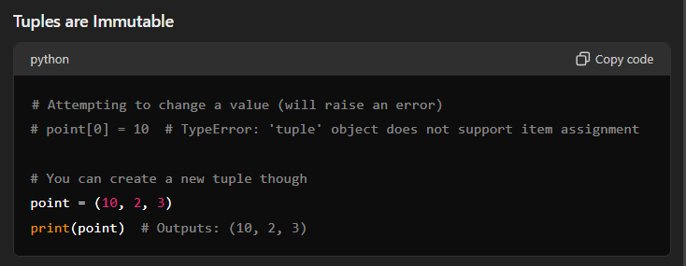

Slide 26
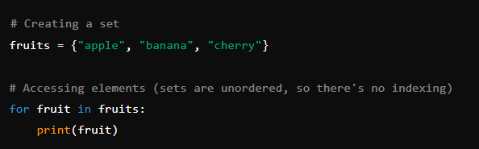
Sets
Sets: Unordered collections of unique items. They are useful for storing items without duplicates.
Creating and Accessing Sets

Slide 27
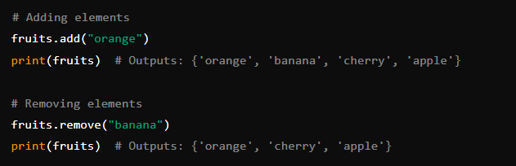
Modifying Sets

Slide 28
LET’S CONTINUE

Slide 29
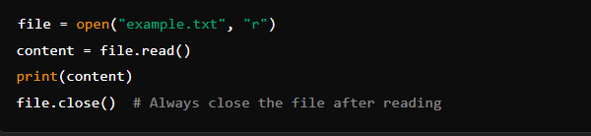
5. File Handling
File handling in Python allows you to read from and write to files. This is essential for many applications, such as data processing and logging.
Reading Files
Opening and Reading Files
Use the open() function to open a file. By default, it opens the file in read mode ‘r’

Slide 30
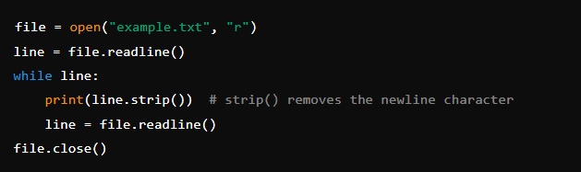
Reading Line by Line
Use the readline() method to read one line at a time.

Slide 31
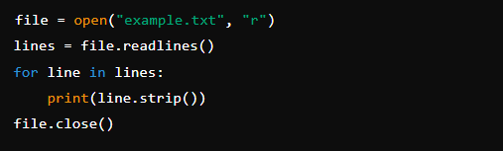
Reading All Lines into a List
Use the readlines() method to read all lines into a list.

Slide 32
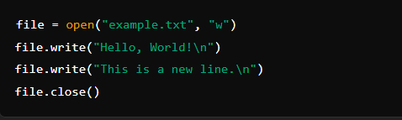
Writing Files
Writing to a File
Use the open() function with the mode (write) to open a file for writing. This will overwrite the existing content.

Slide 33
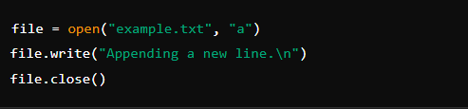
Appending to a File
Use the mode ‘a’ (append) to add content to the end of a file without overwriting the existing content.

Slide 34
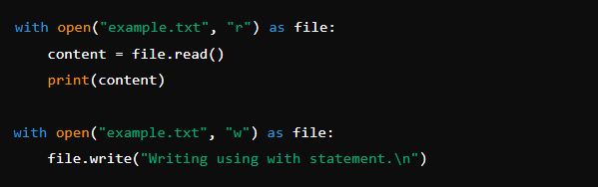
Using ‘with’ Statement
The ‘with’ statement is used to handle file operations. It ensures the file is properly closed after its suite finishes, even if an exception is raised.

Slide 35
6. Error Handling
Error handling in Python allows you to manage errors gracefully and ensure that your programs can handle unexpected situations without crashing.
Understanding Exceptions
Exceptions are errors detected during execution. When an error occurs, Python stops the program and generates an error message. This process is called raising an exception.

Slide 36
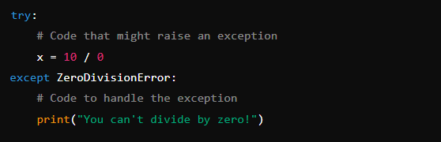
Basic Error Handling
Try and Except Blocks
try: The block of code to be tested for errors.
except: The block of code to be executed if an error occurs.

Slide 37
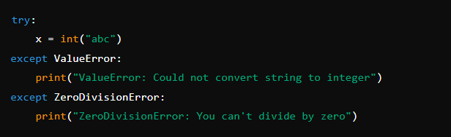
Handling Multiple Exceptions
You can handle multiple exceptions by specifying them in separate except blocks.

Slide 38
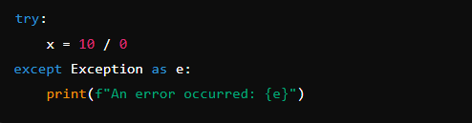
Catching All Exceptions
Use a generic exception to catch all types of exceptions.

Slide 39
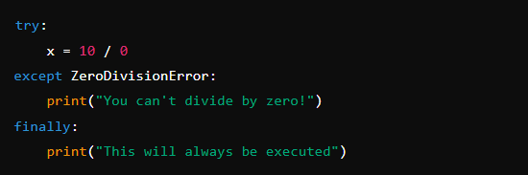
Finally Block
The block of code that will be executed no matter what, even if an exception is raised.

Slide 40
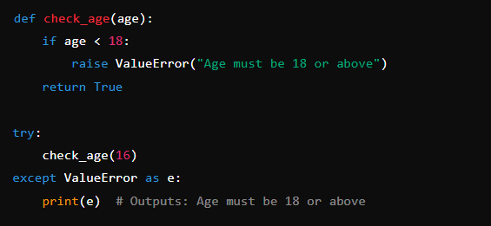
Raising Exceptions
You can raise exceptions using the ‘raise’ keyword.

Slide 41
7. Modules and Packages
Modules and packages in Python help you organize and reuse your code.
They are essential for building large-scale applications and collaborating on code.

Slide 42

Modules
A module is a file containing Python definitions and statements. The file name is the module name with the suffix .py
Importing Modules
Use the import statement to bring in a module.

Slide 43
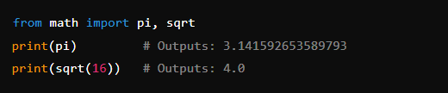

Import specific functions or variables from a module.
Import a module with an alias.

Slide 44
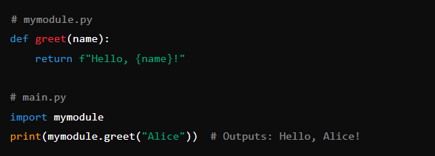
Creating Your Own Module
Create a file named mymodule.py with some functions or variables.

Slide 45
Packages
A package is a way of structuring Python’s module namespace by using "dotted module names".
A package is a directory that contains a special file called ‘__init__.py’ and can contain multiple modules.
Creating a Package
Create a directory for your package.
Add an ‘__init__.py’ file to the directory (this can be an empty file).
Add modules to the package.

Slide 46
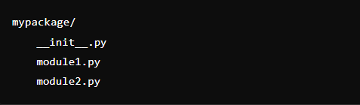
Example structure:

Slide 47
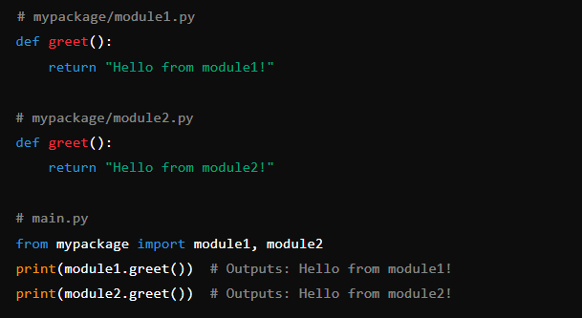
Using a Package

Slide 48
8. Basic Object-Oriented Programming (OOP)
Let's use the concept of a Student to explain the basics of Object-Oriented Programming.
Classes and Objects
Class: A blueprint for creating objects (a particular data structure).
Object: An instance of a class.

Slide 49
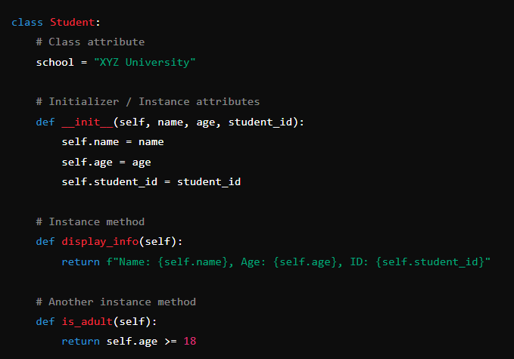
Defining a Class

Slide 50
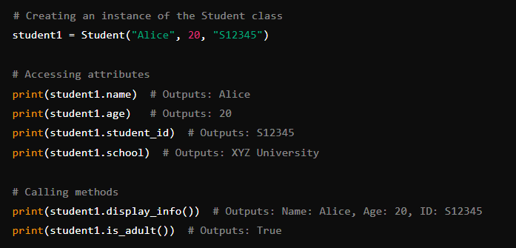
Creating an Object

Slide 51
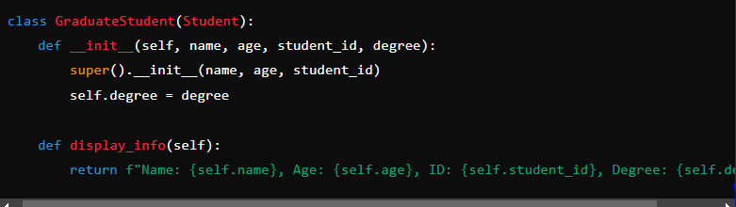
Inheritance
Inheritance allows a class to inherit attributes and methods from another class.
Defining a Subclass

Slide 52
Encapsulation
Encapsulation restricts direct access to some of an object’s components, which can prevent the accidental modification of data.

Slide 53
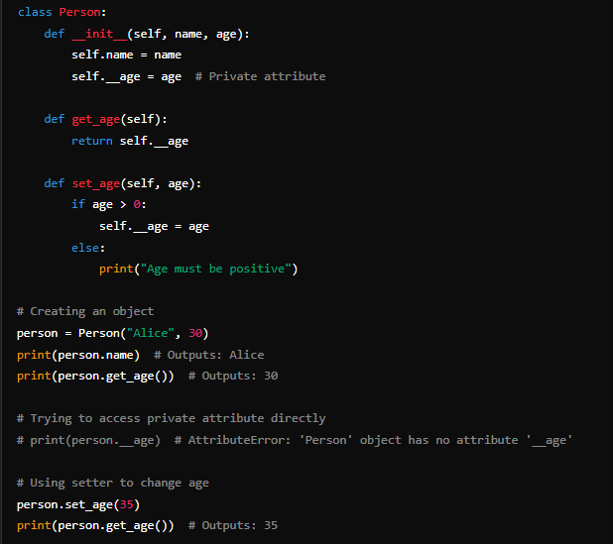

Slide 54
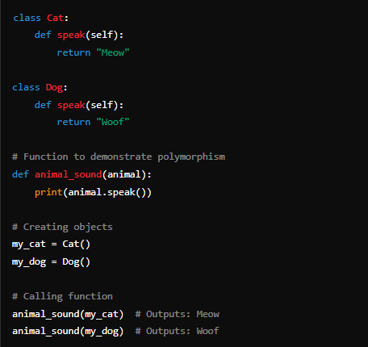
Polymorphism
Polymorphism allows methods to do different things based on the object it is acting upon, even though they share the same name.

Slide 55

Basic Input/Output
Input and output are fundamental aspects of programming that allow a program to interact with users and other systems.
Reading Input
Input() function: This function is used to take input from the user.

Slide 56

Formatting Output
You can format strings in various ways to include variables and expressions within your text.
Using f-strings (Formatted String Literals)

Slide 57

Using the ‘format()’ method

Slide 58
File Modes
r (Read): Opens a file for reading (default). The file must exist.
w (Write): Opens a file for writing. Creates a new file if it does not exist or truncates the file if it exists.
a (Append): Opens a file for appending. Creates a new file if it does not exist.
b (Binary): Binary mode. Used in conjunction with other modes (e.g., rb, wb) to read or write binary files.
t (Text): Text mode (default). Used in conjunction with other modes (e.g., rt, wt) to read or write text files.
x (Exclusive Creation): Creates a new file and opens it for writing. If the file already exists, the operation fails.
+ (Read and Write): Opens a file for updating (reading and writing). Must be used in conjunction with other modes (e.g., r+, w+, a+).

Slide 59
Common File Methods
open(file, mode): Opens a file and returns a corresponding file object.
close(): Closes the file. It is important to close a file when it is no longer needed.
read(size=-1): Reads at most size bytes from the file (reads the entire file if size is not specified or is negative).
readline(size=-1): Reads one entire line from the file. A trailing newline character is kept in the string (but may be absent when a line is incomplete). The size argument is optional.
readlines(hint=-1): Reads all the lines of a file in a list. The hint argument is optional and can specify the number of bytes to read, which might be less than the total length of the file.
write(string): Writes the string to the file.
writelines(lines): Writes a list of lines to the file. There is no newline character added unless explicitly provided.
flush(): Flushes the internal buffer, writing the data to the file.

Slide 60
THANK YOU FOR LISTENING

